Slide 1

Cloud Computing
Simple Chat Server

Slide 2

Cloud Computing
Component Diagram

Slide 3
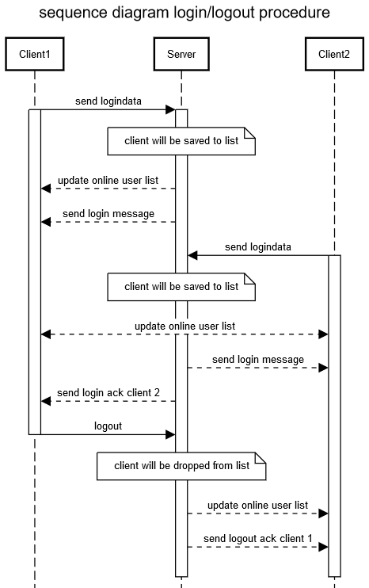
Cloud Computing
Sequence Diagram

Slide 4
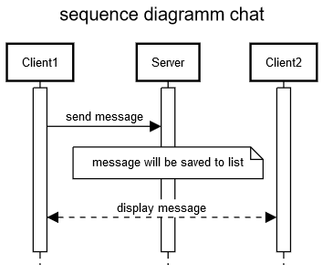
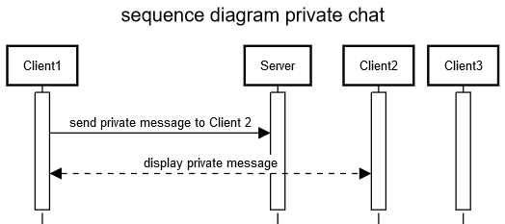
Cloud Computing
Sequence Diagram

Slide 5
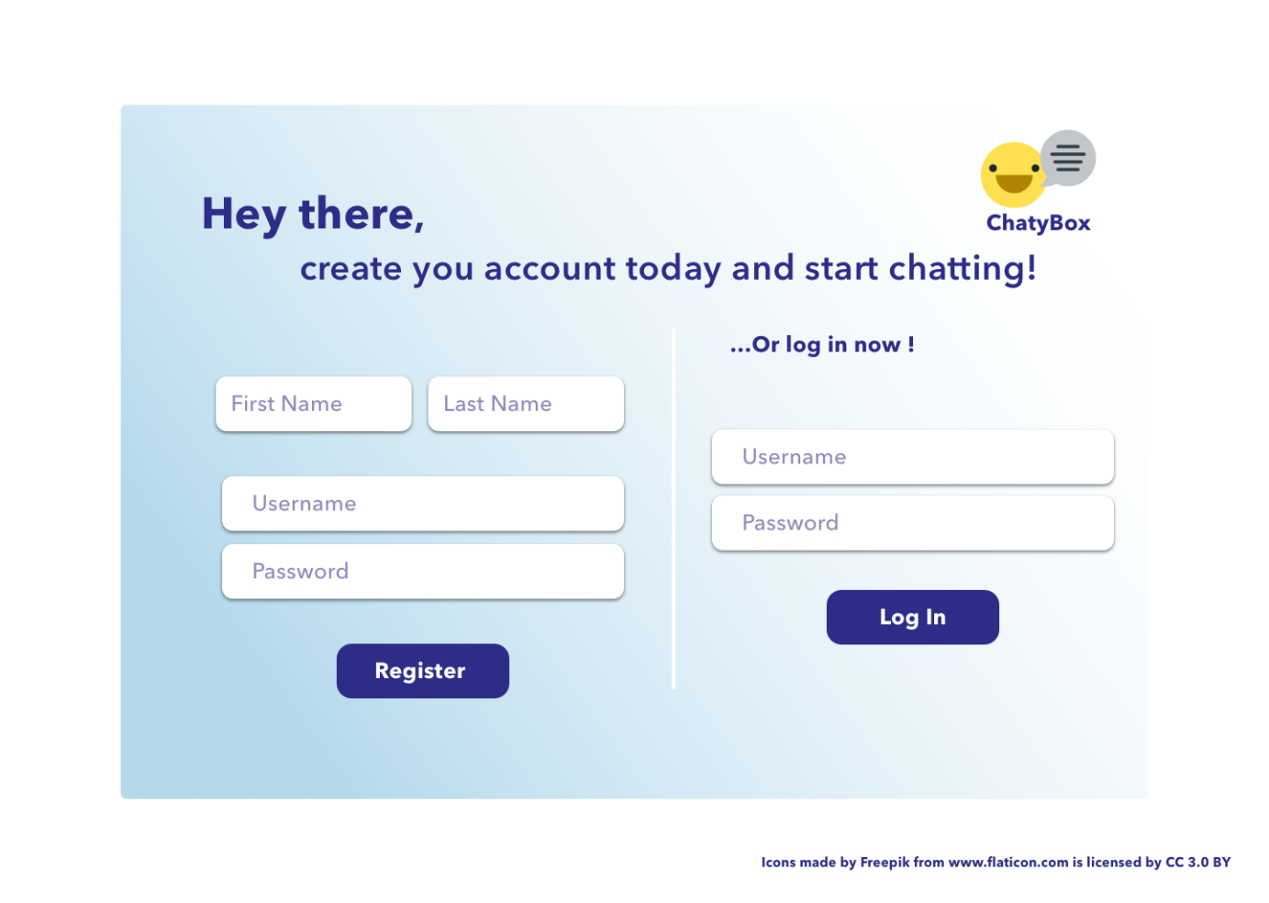
Cloud Computing
Design Mockups

Slide 6
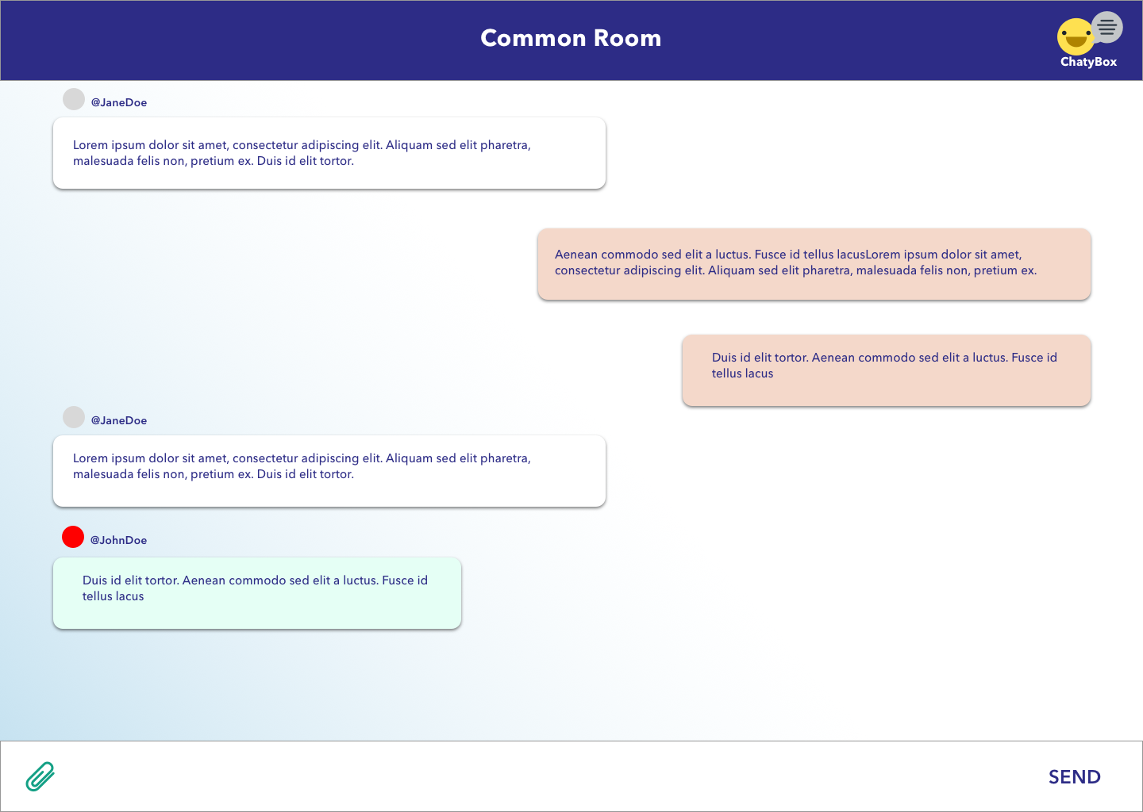
Cloud Computing
Design Mockups

Slide 7
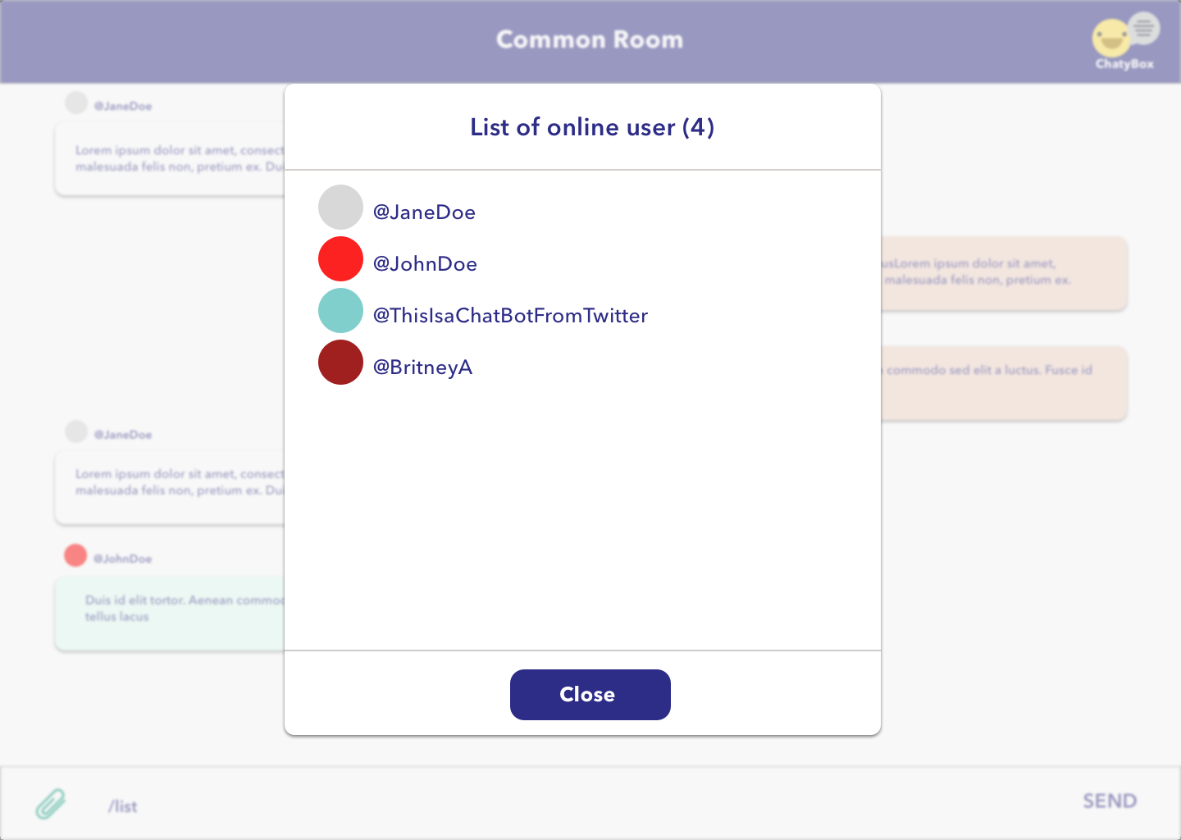
Cloud Computing
Design Mockups

Slide 8
Cloud Computing
Lesson Learned
event-based communication between server and client

